Slide 1

Google Cloud Software Development Kit (SDK) for .NET
Author: Luis Coco Enríquez

Slide 2
Agenda
Topic
What is Google Cloud SDK for .NET?.
Most common use cases.
How to set up your environment.
API Reference.

Slide 3
Agenda
Topic
Code examples with guidance for the Google Cloud SDK for .NET.
Additional code examples for the Google Cloud SDK for .NET.
GitHub repositories.
C# code samples with Google Cloud SDK for .NET.

Slide 4
Google Cloud Platform .NET Cloud Client Libraries
How to create a Google Cloud Free Tier account
Create a gmail account. https://support.google.com/mail/answer/56256?hl=en
2. Set your payment info (credit card data, paypal,… or other).
3. Open an incognito Chrome window and login in Google Cloud.
4. Login in Google Cloud. https://console.cloud.google.com/
5. Activate the free tier subscription.
6. First sample: create a new Bucket (for storing data).

Slide 5
Google Cloud Platform .NET Cloud Client Libraries
Setting up a .NET development environment
1. Install your IDE: Visual Studio or VS Code. https://visualstudio.microsoft.com/
https://code.visualstudio.com/download
2. Create a Google Cloud project. Create a Google Cloud project to run your apps. Google Cloud projects form the basis for creating, enabling, and using all Google Cloud services.
3. Authentication. Your .NET app must authenticate itself to use Google Cloud APIs. You use Application Default Credentials (ADC), which let you provide credentials for either local development or in a production environment.
For information about setting up ADC, see Provide credentials to Application Default Credentials. For general information about authentication, see Authentication at Google.
https://cloud.google.com/dotnet/docs/setup?hl=en

Slide 6
Google Cloud Platform .NET Cloud Client Libraries
Set up Application Default Credentials (ADC)
https://cloud.google.com/docs/authentication/provide-credentials-adc#local-dev
1. Install “gcloud CLI” https://cloud.google.com/sdk/docs/install?hl=en
2. Create your credential file (run the command):
gcloud auth application-default login
This method stores your credentials in a file on your file system. Any user with access to your file system can use those credentials. When you no longer need these credentials, you should revoke them:
gcloud auth application-default revoke
User credentials might not work for some methods and APIs, such as the Cloud Translation API or the Cloud Vision API, without extra parameters or configuration. See Troubleshooting your ADC setup.
https://cloud.google.com/dotnet/docs/setup?hl=en

Slide 7
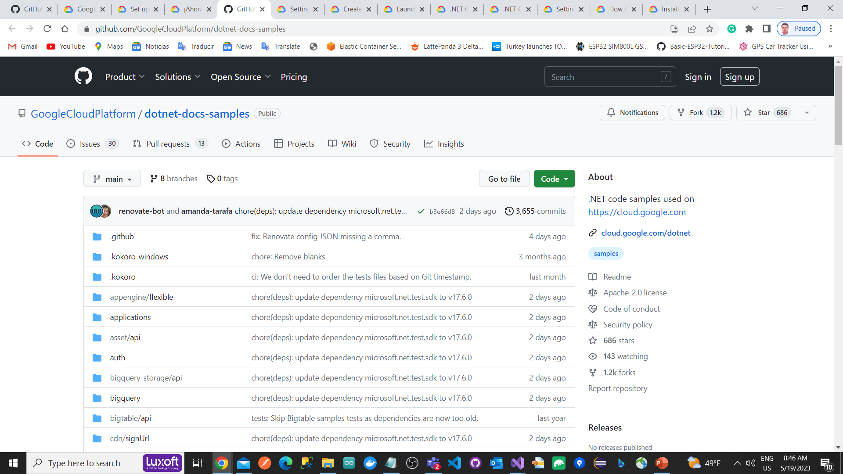
Google Cloud Platform .NET Cloud Client Libraries
https://github.com/GoogleCloudPlatform/dotnet-docs-samples

Slide 8
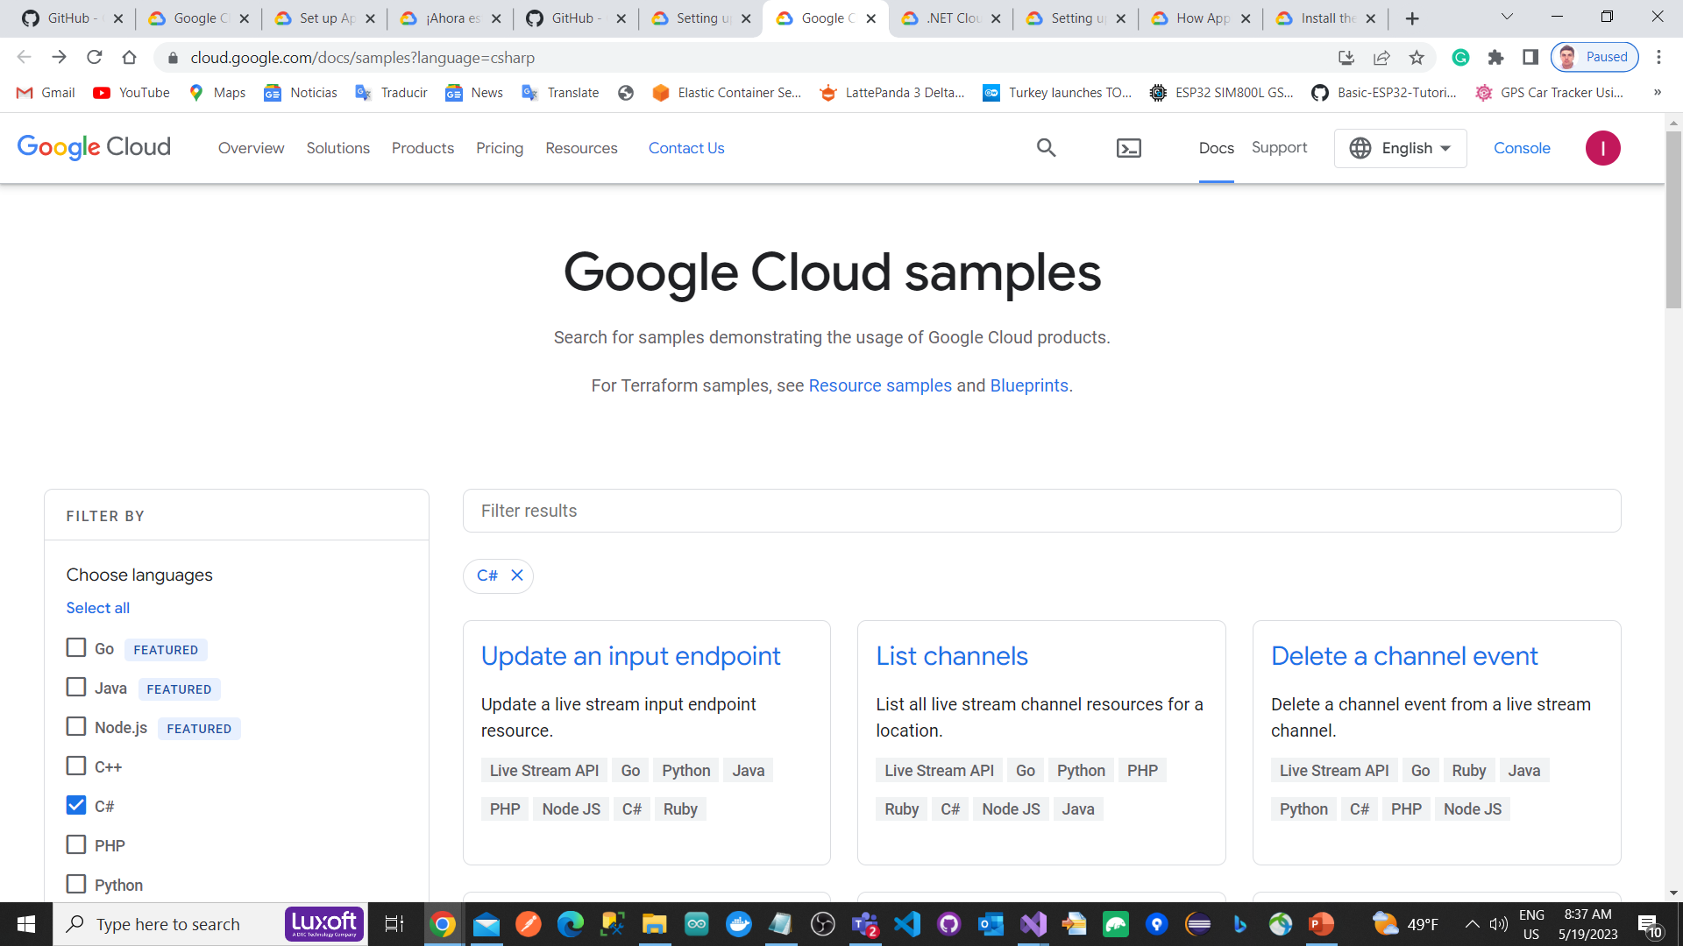
Google Cloud Platform .NET Cloud Client Libraries
https://cloud.google.com/docs/samples?language=csharp

Slide 9
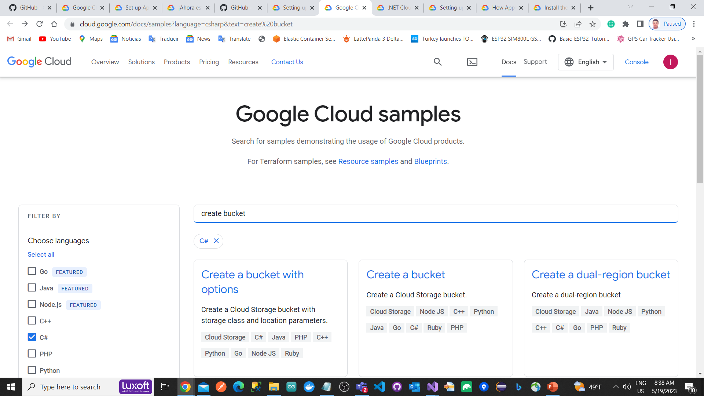
Google Cloud Platform .NET Cloud Client Libraries
https://cloud.google.com/docs/samples?language=csharp&text=create%20bucket

Slide 10
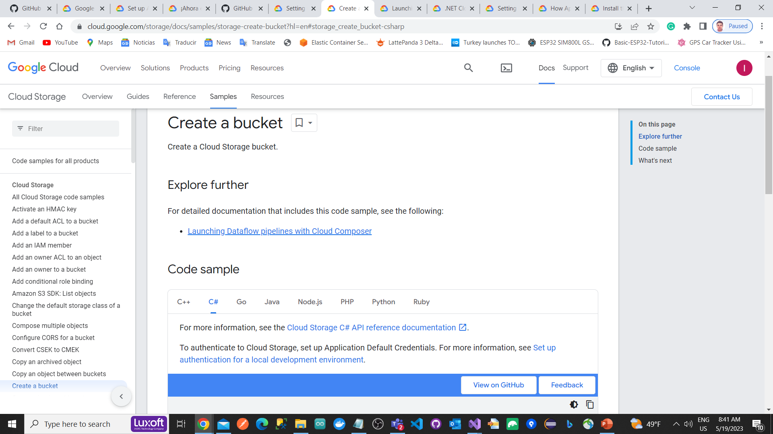
Google Cloud Platform .NET Cloud Client Libraries
https://cloud.google.com/storage/docs/samples/storage-create-bucket?hl=en#storage_create_bucket-csharp

Slide 11
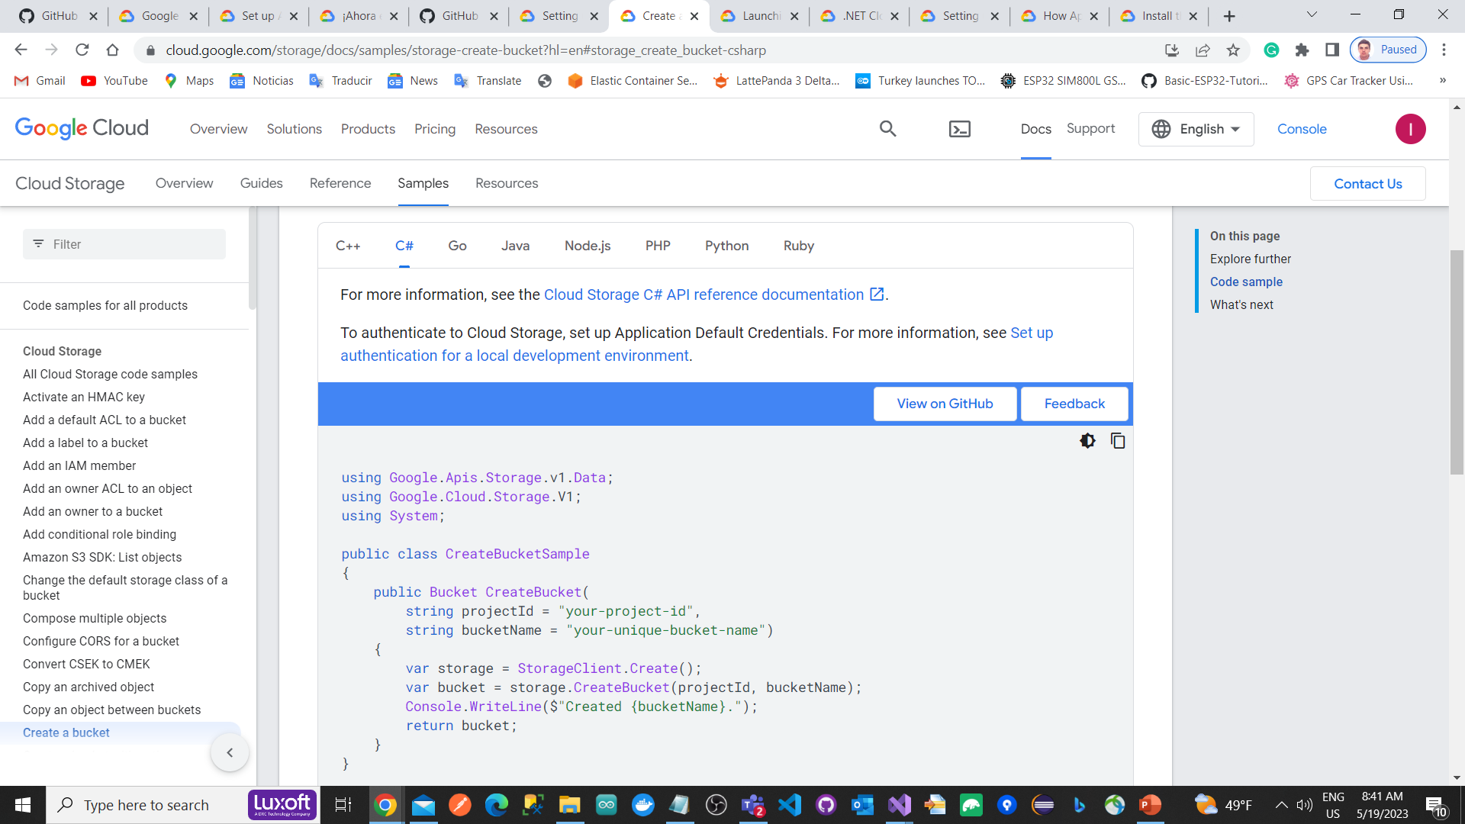
Google Cloud Platform .NET Cloud Client Libraries

Slide 12
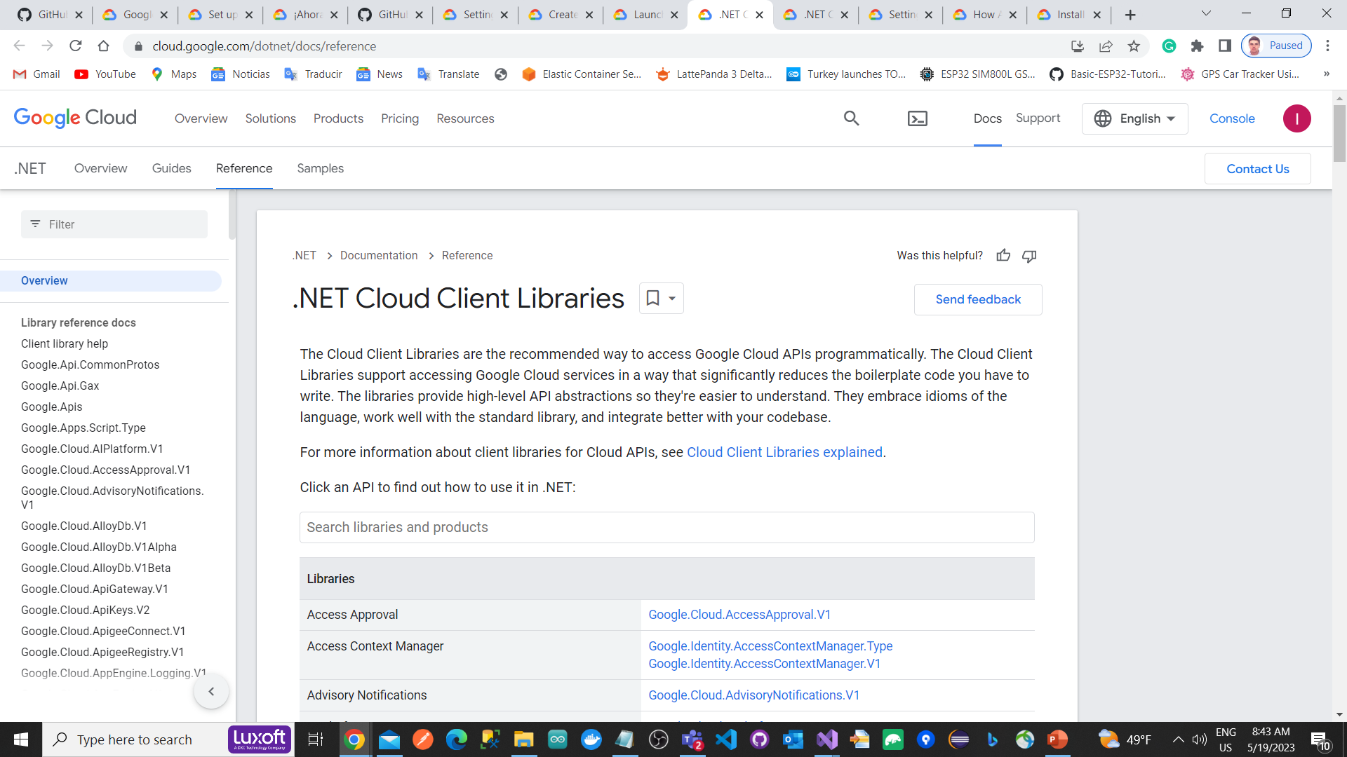
Google Cloud Platform .NET Cloud Client Libraries
https://cloud.google.com/dotnet/docs/reference

Slide 13
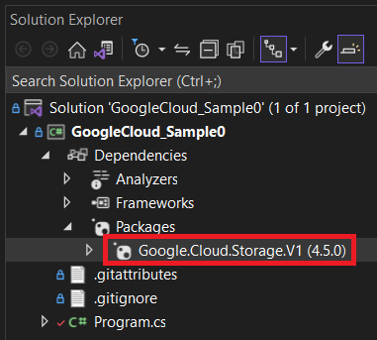
Google Cloud Platform .NET Cloud Client Libraries
Buckets
using Google.Apis.Storage.v1.Data;
using Google.Cloud.Storage.V1;
string projectId = "focus-cache-387205";
string bucketName = "luiscocoenriquezsegundo";
string localPath = "C://NetChapterArticles.txt";
string objectName = "NetChapterArticles.txt";
//-----------------------------------------------------------------------------
//Create Bucket
//-----------------------------------------------------------------------------
var storage = StorageClient.Create();
var bucket = storage.CreateBucket(projectId, bucketName);
Console.WriteLine($"Created {bucketName}.");
//-----------------------------------------------------------------------------
//List Buckets
//-----------------------------------------------------------------------------
//var storage = StorageClient.Create();
var bucketsluis = storage.ListBuckets(projectId);
Console.WriteLine("Buckets:");
foreach (var bucketluis in bucketsluis)
{
Console.WriteLine(bucketluis.Name);
}
//-----------------------------------------------------------------------------
//File Upload
//-----------------------------------------------------------------------------
using var fileStream = File.OpenRead(localPath);
storage.UploadObject(bucketName, objectName, null, fileStream);
Console.WriteLine($"Uploaded {objectName}.");
//-----------------------------------------------------------------
//File Download
//-----------------------------------------------------------------
string downloadlocalpath = "C:\\New folder\\DownloadedFile.txt";
using var outputFile = File.OpenWrite(downloadlocalpath);
storage.DownloadObject(bucketName, objectName, outputFile);
Console.WriteLine($"Downloaded {objectName} to {localPath}.");
//------------------------------------------------------------------
//List Files
//------------------------------------------------------------------
var storageObjects = storage.ListObjects(bucketName);
Console.WriteLine($"Files in bucket {bucketName}:");
foreach (var storageObject in storageObjects)
{
Console.WriteLine(storageObject.Name);
}

Slide 14
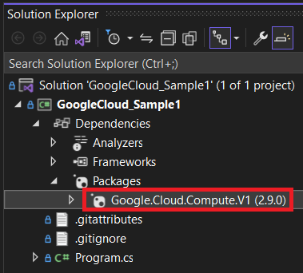
Google Cloud Platform .NET Cloud Client Libraries
Creating a Virtual Machine
using Google.Cloud.Compute.V1;
string projectId = "focus-cache-387205";
string zone = "europe-southwest1-a";
string machineName = "luis-test-machine";
string machineType = "e2-micro";
string diskImage = "projects/debian-cloud/global/images/family/debian-10";
long diskSizeGb = 10;
string networkName = "default";
Instance instance = new Instance
{
Name = machineName,
MachineType = $"zones/{zone}/machineTypes/{machineType}",
Disks =
{
new AttachedDisk
{
AutoDelete = true,
Boot = true,
Type = ComputeEnumConstants.AttachedDisk.Type.Persistent,
InitializeParams = new AttachedDiskInitializeParams
{
SourceImage = diskImage,
DiskSizeGb = diskSizeGb
}
}
},
NetworkInterfaces = { new NetworkInterface { Name = networkName } }
};
InstancesClient client = await InstancesClient.CreateAsync();
var instanceCreation = await client.InsertAsync(projectId, zone, instance);
await instanceCreation.PollUntilCompletedAsync();

Slide 15
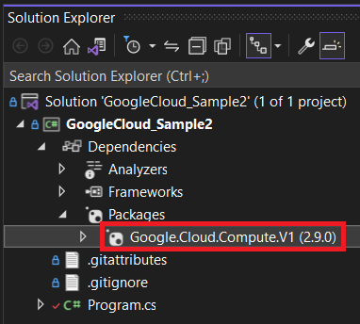
Google Cloud Platform .NET Cloud Client Libraries
Deleting a Virtual Machine
// Start the VM instance before deleting it.
//var startRequest = new StartInstanceRequest
//{
// Project = projectId,
// Zone = zone,
// Instance = machineName
//};
//await client.StartAsync(startRequest);
// Make the request to delete a VM instance.
var instanceDeletion = await client.DeleteAsync(projectId, zone, machineName);
//Wait for the operation to complete using client-side polling.
await instanceDeletion.PollUntilCompletedAsync();
using Google.Api;
using Google.Cloud.Compute.V1;
string projectId = "focus-cache-387205";
string zone = "europe-southwest1-a";
string machineName = "luis-test-machine";
InstancesClient client = await InstancesClient.CreateAsync();
// Stop the VM instance before deleting it.
var stopRequest = new StopInstanceRequest
{
Project = projectId,
Zone = zone,
Instance = machineName
};
await client.StopAsync(stopRequest);

Slide 16
Google Cloud Platform .NET Cloud Client Libraries
Listing Virtual Machines
Listing Virtual Machines Types
using Google.Cloud.Compute.V1;
string projectId = "focus-cache-387205";
InstancesClient client = await InstancesClient.CreateAsync();
IList<Instance> allInstances = new List<Instance>();
// Make the request to list all VM instances in a project.
await foreach (var instancesByZone in client.AggregatedListAsync(projectId))
{
Console.WriteLine($"Instances for zone: {instancesByZone.Key}");
foreach (var instance in instancesByZone.Value.Instances)
{
Console.WriteLine($"-- Name: {instance.Name}");
allInstances.Add(instance);
}
}
using Google.Cloud.Compute.V1;
MachineTypesClient machineTypesClient = MachineTypesClient.Create();
ImagesClient imagesClient = ImagesClient.Create();
// List machine types
var machineTypesList = machineTypesClient.List(new ListMachineTypesRequest
{
Project = "focus-cache-387205",
Zone = "europe-southwest1-a"
});
Console.WriteLine("Machine Types:");
foreach (MachineType machineType in machineTypesList)
{
Console.WriteLine($"- {machineType.Name}");
}
Console.WriteLine();

Slide 17
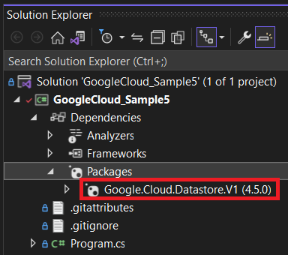
Google Cloud Platform .NET Cloud Client Libraries
Datastore
using Google.Cloud.Datastore.V1;
string projectId = "focus-cache-387205";
DatastoreDb db = DatastoreDb.Create(projectId);
string kind = "Task";
string name = "sampletask1";
KeyFactory keyFactory = db.CreateKeyFactory(kind);
Key key = keyFactory.CreateKey(name);
var task = new Entity
{
Key = key,
["description"] = "Buy milk"
};
using (DatastoreTransaction transaction = db.BeginTransaction())
{
// Saves the task
transaction.Upsert(task);
transaction.Commit();
Console.WriteLine($"Saved {task.Key.Path[0].Name}: {(string)task["description"]}");
}

Slide 18
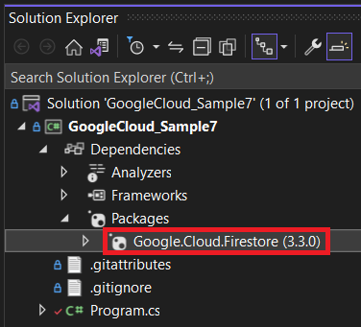
Google Cloud Platform .NET Cloud Client Libraries
Firestore
async Task RetrieveAllDocuments(string project)
{
FirestoreDb db = FirestoreDb.Create(project);
CollectionReference usersRef = db.Collection("users");
QuerySnapshot snapshot = await usersRef.GetSnapshotAsync();
foreach (DocumentSnapshot document in snapshot.Documents)
{
Console.WriteLine("User: {0}", document.Id);
Dictionary<string, object> documentDictionary = document.ToDictionary();
Console.WriteLine("First: {0}", documentDictionary["First"]);
if (documentDictionary.ContainsKey("Middle"))
{
Console.WriteLine("Middle: {0}", documentDictionary["Middle"]);
}
Console.WriteLine("Last: {0}", documentDictionary["Last"]);
Console.WriteLine("Born: {0}", documentDictionary["Born"]);
Console.WriteLine();
}
}
using Google.Cloud.Firestore;
string project = "focus-cache-387205";
AddData1(project).Wait();
RetrieveAllDocuments(project).Wait();
void InitializeProjectId(string project)
{
FirestoreDb db = FirestoreDb.Create(project);
Console.WriteLine("Created Cloud Firestore client with project ID: {0}", project);
}
async Task AddData1(string project)
{
FirestoreDb db = FirestoreDb.Create(project);
DocumentReference docRef = db.Collection("users").Document("alovelace");
Dictionary<string, object> user = new Dictionary<string, object>
{
{ "First", "Ada" },
{ "Last", "Lovelace" },
{ "Born", 1815 }
};
await docRef.SetAsync(user);
Console.WriteLine("Added data to the alovelace document in the users collection.");
}

Slide 19
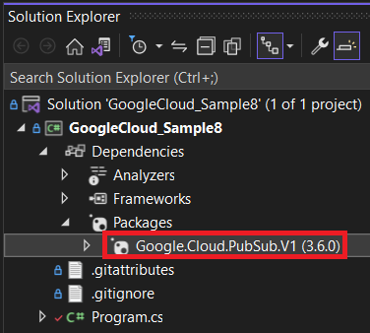
Google Cloud Platform .NET Cloud Client Libraries
Pub/Sub
//Create a Subscription for the topic
SubscriberServiceApiClient subscriber = SubscriberServiceApiClient.Create();
SubscriptionName subscriptionName = SubscriptionName.FromProjectSubscription(projectId, subscriptionId);
Subscription subscription = null;
try
{
subscription = subscriber.CreateSubscription(subscriptionName, topicName,
pushConfig: null, ackDeadlineSeconds: 60);
}
catch (RpcException e) when (e.Status.StatusCode == StatusCode.AlreadyExists)
{
// Already exists. That's fine.
}
using Google.Cloud.PubSub.V1;
using Grpc.Core;
string projectId = "focus-cache-387205";
string topicId = "luis-topic-1";
string subscriptionId = "subscription-first";
//Create a topic
PublisherServiceApiClient publisher = PublisherServiceApiClient.Create();
var topicName = TopicName.FromProjectTopic(projectId, topicId);
Topic topic = null;
try
{
topic = publisher.CreateTopic(topicName);
Console.WriteLine($"Topic {topic.Name} created.");
}
catch (RpcException e) when (e.Status.StatusCode == StatusCode.AlreadyExists)
{
Console.WriteLine($"Topic {topicName} already exists.");
}

Slide 20
Google Cloud Platform .NET Cloud Client Libraries
Pub/Sub
//Publish messages to the above created topic
PublisherClient publisher1 = await PublisherClient.CreateAsync(topicName);
int publishedMessageCount = 0;
List<string> messageTexts = new List<string>();
messageTexts.Add("First message");
messageTexts.Add("Second message");
messageTexts.Add("Third message");
messageTexts.Add("Fourth message");
messageTexts.Add("Fifth message");
var publishTasks = messageTexts.Select(async text =>
{
try
{
string message = await publisher1.PublishAsync(text);
Console.WriteLine($"Published message {message}");
Interlocked.Increment(ref publishedMessageCount);
}
catch (Exception exception)
{
Console.WriteLine($"An error ocurred when publishing message {text}: {exception.Message}");
}
});
await Task.WhenAll(publishTasks);

Slide 21
Google Cloud Platform .NET Cloud Client Libraries
Pub/Sub
int messages_Count_received = PullMessagesSync(projectId, subscriptionId, true);
int PullMessagesSync(string projectId, string subscriptionId, bool acknowledge)
{
SubscriptionName subscriptionName = SubscriptionName.FromProjectSubscription(projectId, subscriptionId);
SubscriberServiceApiClient subscriberClient = SubscriberServiceApiClient.Create();
int messageCount = 0;
try
{
// Pull messages from server,
PullResponse response = subscriberClient.Pull(subscriptionName, maxMessages: 20);
foreach (ReceivedMessage msg in response.ReceivedMessages)
{
string text = System.Text.Encoding.UTF8.GetString(msg.Message.Data.ToArray());
Console.WriteLine($"Message {msg.Message.MessageId}: {text}");
Interlocked.Increment(ref messageCount);
}
if (acknowledge && messageCount > 0)
{
subscriberClient.Acknowledge(subscriptionName, response.ReceivedMessages.Select(msg => msg.AckId));
}
}
catch (RpcException ex) when (ex.Status.StatusCode == StatusCode.Unavailable)
{
// UNAVAILABLE due to too many concurrent pull requests pending for the given subscription.
}
return messageCount;
}

Slide 22
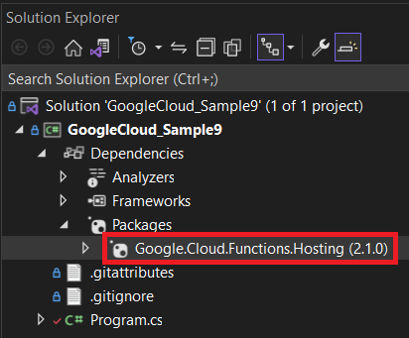
Google Cloud Platform .NET Cloud Client Libraries
Functions
using Google.Cloud.Functions.Framework;
using Microsoft.AspNetCore.Http;
namespace HelloWorld;
public class Function : IHttpFunction
{
public async Task HandleAsync(HttpContext context)
{
await context.Response.WriteAsync("Hello World!");
}
}
https://cloud.google.com/functions/docs/concepts/overview

Slide 23
Google Cloud Platform .NET Cloud Client Libraries
Functions
using CloudNative.CloudEvents;
using Google.Cloud.Functions.Framework;
using Google.Events.Protobuf.Cloud.Storage.V1;
using Microsoft.Extensions.Logging;
using System.Threading;
using System.Threading.Tasks;
namespace HelloGcs;
/// <summary>
/// Example Cloud Storage-triggered function.
/// This function can process any event from Cloud Storage.
/// </summary>
public class Function : ICloudEventFunction<StorageObjectData>
{
private readonly ILogger _logger;
public Function(ILogger<Function> logger) =>
_logger = logger;
public Task HandleAsync(CloudEvent cloudEvent, StorageObjectData data, CancellationToken cancellationToken)
{
_logger.LogInformation("Event: {event}", cloudEvent.Id);
_logger.LogInformation("Event Type: {type}", cloudEvent.Type);
_logger.LogInformation("Bucket: {bucket}", data.Bucket);
_logger.LogInformation("File: {file}", data.Name);
_logger.LogInformation("Metageneration: {metageneration}", data.Metageneration);
_logger.LogInformation("Created: {created:s}", data.TimeCreated?.ToDateTimeOffset());
_logger.LogInformation("Updated: {updated:s}", data.Updated?.ToDateTimeOffset());
return Task.CompletedTask;
}
}

